Slide 1
Regular Expressions
CS 236
Fall 2023

Slide 2
Overview and Due
Regular Expressions
Symbols, strings, languages, vocabulary
Regular expressions – recursive definition
A* is the trickiest
Precedence
To note
Please read before class on Wednesday – class is flipped
You’ll be ready to start project 1 after class Sept 18
Due
HW 1 due today
Project 0 due Wednesday, Sep 13
Project 1 due Thursday, Sept 28

Slide 3
Why Regular Expressions
Some sets have patterns that can be expressed in efficient ways

Slide 4
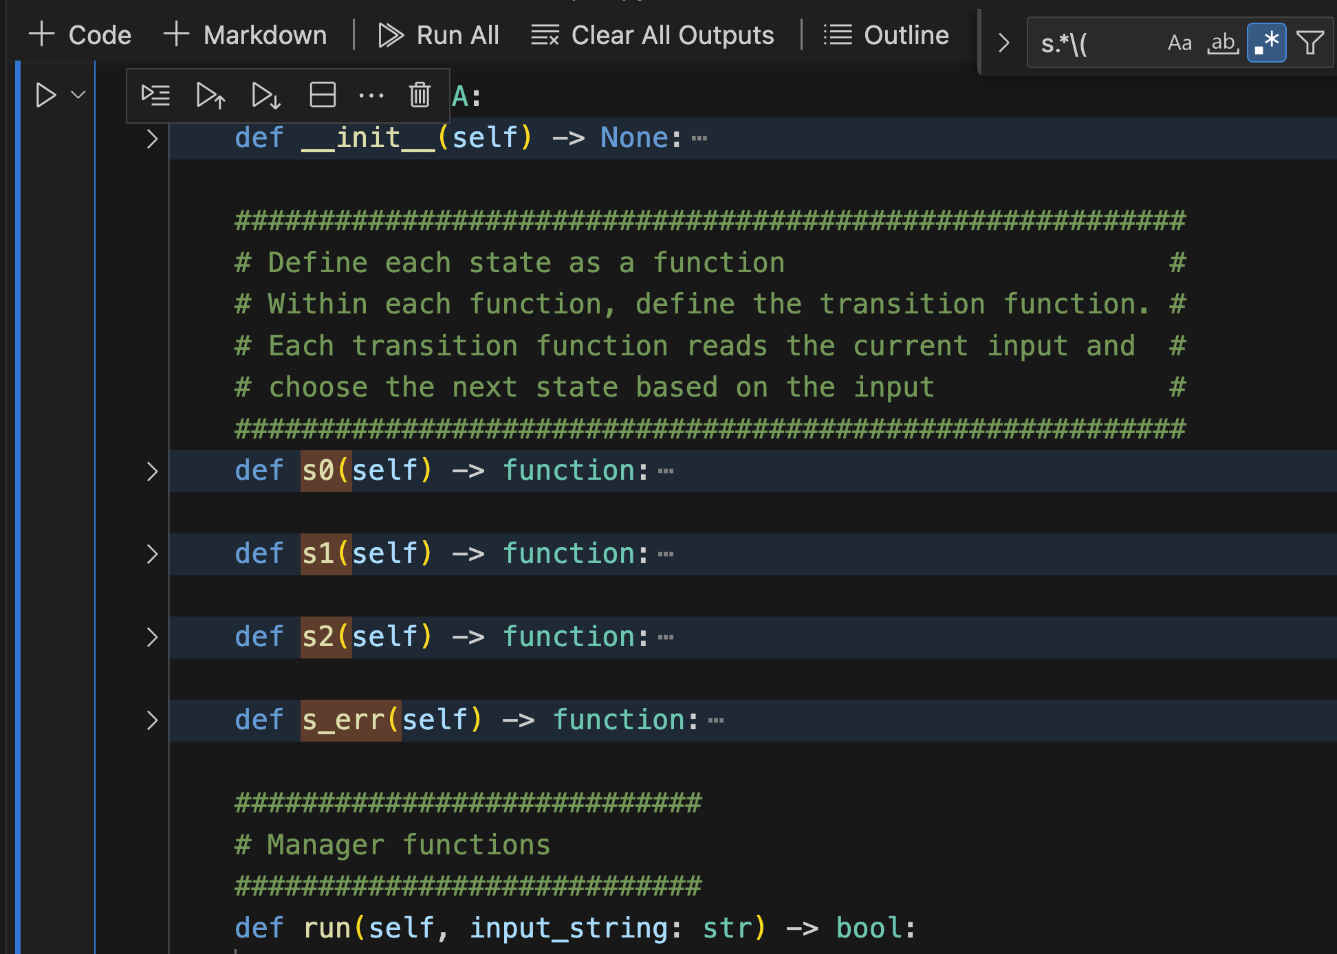
Select the VSCode search feature

Slide 5
Click on .*

Slide 6
I can search for all strings that match a pattern that I specify

Slide 7
There are rules that tell me what the pattern means

Slide 8
This pattern means
strings start with “s”
followed by any number of characters
followed by an opening parenthesis

Slide 9
Why Regular Expressions?
Regular expressions allow us to use a shorthand notation to specify patterns of “things”
But only certain, well-known and historically useful patterns can be described using regular expressions

Slide 10
Necessary Definitions

Slide 11
Regular Expressions and Languages
Recall this is a “math-first” course
Just as in any area of mathematics, we must formally define terms

Slide 12
Vocabulary – From Def 1 §13.3.2
The vocabulary of a language is a set of “allowed” symbols
V = { a, b, c}
V* is the set of all possible strings that can be created from the symbols in V

Slide 13
Vocabulary – From Def 1 §13.3.2
The vocabulary of a language is a set of “allowed” symbols
V = { a, b, c}
V* is the set of all possible strings that can be created from the symbols in V
Think of V* as the set of all words, sensical or nonsensical, that can be created using a given alphabet

Slide 14
What is a symbol, string, language? (and vocabulary)
A symbol is an element of a vocabulary set
Think of it as a character
A string is a sequence of symbols (elements of V*)
Think of it as a sequence of characters, meaning a word
A language is a set of strings
Think of it as a collection of strings inside curly braces
L = { … }

Slide 15
Symbol, string, or language?
V = {a,b,c,d,1,2,3,4}
a
123
1
abc
{a, ab, abc}
{123}
𝜆
{ }

Slide 16
Symbol, string, or language?
a -> symbol (also string)
123 -> string
1 -> symbol (also string)
abc -> string
{a, ab, abc} -> language
{123} -> language
𝜆 -> string (empty)
{ } -> language (empty)
V = {a,b,c,d,1,2,3,4}

Slide 17
Symbol, string, or language?
a -> symbol (also string)
123 -> string
1 -> symbol (also string)
abc -> string
{a, ab, abc} -> language
{123} -> language
𝜆 -> string (empty)
{ } -> language (empty)
a string that is made up of concatenating 0 symbols together
Notes:
Empty string: a string that is made up of concatenating 0 symbols together
Empty language: a set of strings that contains no strings

Slide 18
Symbol, string, or language?
a -> symbol (also string)
123 -> string
1 -> symbol (also string)
abc -> string
{a, ab, abc} -> language
{123} -> language
𝜆 -> string (empty)
{ } -> language (empty)
a set containing no strings
Notes:
Empty string: a string that is made up of concatenating 0 symbols together
Empty language: a set of strings that contains no strings

Slide 19
Generators and Recognizers
We can do “computing stuff” with languages using two kinds of tools: generators and recognizers
Generators are tools we use to create all strings in a language
Regular expressions generate certain kinds of languages
Recognizers are tools we use to check whether a particular string is in a particular language
Finite state automata (discussed next Friday) recognize certain kinds of languages

Slide 20
Generators and Recognizers
Generators are tools we use to create all strings in a language
Recognizers are tools we use to check whether a particular string is in a particular language. Let L denote the language and s denote a string
Language
(set of strings)
Outputs every string s in L
Generator
a string s
someone gives us
Recognizer
Is s in L

Slide 21
Regular Expression Definition

Slide 22
Regular Expression – Def1 §13.4.1
Recursive definition
Base cases are ∅, λ, and a

Slide 23
Regular Expression – Def1 §13.4.1
Recursive definition
Base cases are ∅, λ, and a
Operations are
concatenation: AB
union: A ∪ B
Kleene star: A*
where A and B are regular expressions

Slide 24
Regular Expression – Def1 §13.4.1
Recursive definition
Base cases are ∅, λ, and a
Operations are
concatenation: AB
union: A ∪ B
Kleene star: A*
where A and B are regular expressions
Regular expressions generate sets of strings
Regular expressions are shorthand ways of describing languages

Slide 25
Regular Expression – Def1 §13.4.1
Regular expressions generate sets of strings
Regular expressions are shorthand ways of describing languages
Recursive definition
Base cases are ∅, λ, and a
Operations are
concatenation: AB
union: A ∪ B
Kleene star: A*
where A and B are regular expressions
Examples:
ls *.cpp (in linux)
google regular expression search
regular expression search in VSCode

Slide 26
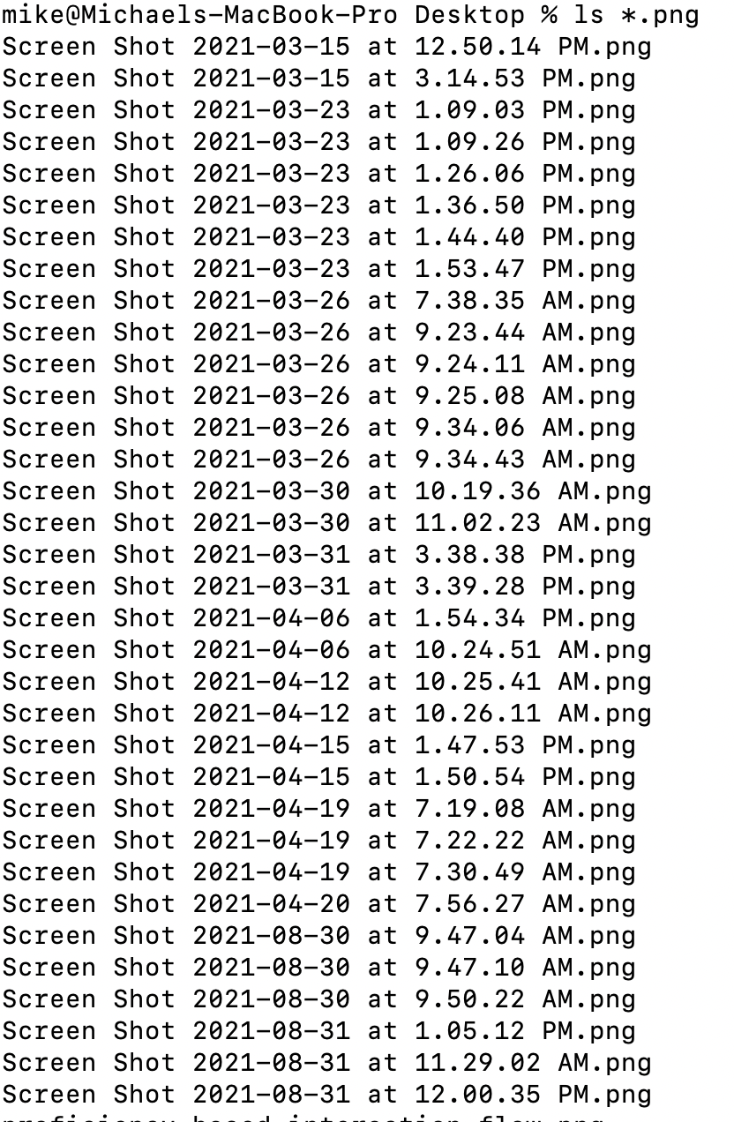

Slide 28
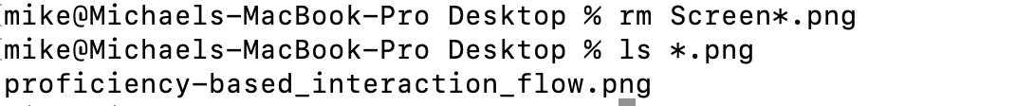

Slide 29
Regular Expression – Def1 §13.4.1
Regular expressions generate sets of strings
Regular expressions are shorthand ways of describing languages
Recursive definition
Base cases are ∅, λ, and a
Operations are
concatenation: AB
union: A ∪ B
Kleene star: A*
where A and B are regular expressions
Examples:
ls *.cpp (in linux)
google regular expression search

Slide 30
Discussing each part of the definition

Slide 31
Regular Expression
Recursive definition
Base cases are ∅, λ, and a
Operations are
concatenation: AB
union: A ∪ B
Kleene star: A*
where A and B are regular expressions
Let’s talk about the base cases

Slide 32
Regular Expression
Regular expression ∅ represents the empty set
L = { }

Slide 33
Regular Expression
Regular expression ∅ represents the empty set
L = { }
A regular expressions describes a language
A language is a set of strings
Is L a language?

Slide 34
Regular Expression
Regular expression ∅ represents the empty set
L = { }
Regular expression λ represents the set containing the empty string
L = { λ }

Slide 35
Regular Expression
Regular expression ∅ represents the empty set
L = { }
Regular expression λ represents the set containing the empty string
L = { λ }
How many elements are in this set?

Slide 36
Regular Expression
Regular expression ∅ represents the empty set
L = { }
Regular expression λ represents the set containing the empty string
L = { λ }
How many elements are in this set?
It’s a language containing one string.

Slide 37
Regular Expression
Regular expression ∅ represents the empty set
L = { }
Regular expression λ represents the set containing the empty string
L = { λ }
Regular expression a represents the set containing the string with the single symbol a
L = { a } It might help to think of it as L = {“a”}

Slide 38
Regular Expression
Regular expression ∅ represents the empty set
L = { }
Regular expression λ represents the set containing the empty string
L = { λ }
Regular expression a represents the set containing the string with the single symbol a
L = { a } It might help to think of it as L = {“a”}
How many elements are in this set?

Slide 39
Regular Expression
Regular expression ∅ represents the empty set
L = { }
Regular expression λ represents the set containing the empty string
L = { λ }
Regular expression a represents the set containing the string with the single symbol a
L = { a } It might help to think of it as L = {“a”}
How many elements are in this set?
It’s a language containing one string.

Slide 40
Regular Expression
Recursive definition
Base cases are ∅, λ, and a
Operations are
concatenation: AB
union: A ∪ B
Kleene star: A*
where A and B are regular expressions
Let’s talk about the operations

Slide 41
Regular Expression
Recursive definition
Base cases are ∅, λ, and a
Operations are
concatenation: AB
union: A ∪ B
Kleene star: A*
where A and B are regular expressions
Concatenation:
AB is set of xy’s where
x is from A and
y is from B
V = {1,2,3,4}
A = {1,2}
B = {3,4}

Slide 42
Regular Expression
Recursive definition
Base cases are ∅, λ, and a
Operations are
concatenation: AB
union: A ∪ B
Kleene star: A*
where A and B are regular expressions
Concatenation:
AB is set of xy’s where
x is from A and
y is from B
V = {1,2,3,4}
A = {1,2}
B = {3,4}
AB = {13,14,23,24}
Notes:
AB = new empty set = {}
for each x in A
for each y in B
add xy to set AB

Slide 43
Regular Expression
Recursive definition
Base cases are ∅, λ, and a
Operations are
concatenation: AB
union: A ∪ B
Kleene star: A*
where A and B are regular expressions
Concatenation:
AB is set of xy’s where
x is from A and
y is from B
V = {1,2,3,4}
A = {1,2}
B = {3,4}
AB = {13,14,23,24}
The elements from A always come first.
Usually, AB ≠ BA
Notes:
AB = new empty set = {}
for each x in A
for each y in B
add xy to set AB

Slide 44
Regular Expression
Recursive definition
Base cases are ∅, λ, and a
Operations are
concatenation: AB
union: A ∪ B
Kleene star: A*
where A and B are regular expressions
Union:
A ∪ B is set of x’s where
x can be from A or
x can be from B
V = {1,2,3,4}
A = {13,22}
B = {3,4}

Slide 45
Regular Expression
Recursive definition
Base cases are ∅, λ, and a
Operations are
concatenation: AB
union: A ∪ B
Kleene star: A*
where A and B are regular expressions
Union:
A ∪ B is set of x’s where
x can be from A or
x can be from B
V = {1,2,3,4}
A = {13,22}
B = {3,4}
A ∪ B = {13,22,3,4}
Notes:
AunionB = emptyset = {}
for x in A
add x to AunionB
for x in B
add x to AunionB

Slide 46
And now, the trickiest part of the definition …
… once you get past using recursion in a definition

Slide 47
Kleene Star
Regular expression A* means zero or more instances of the regular expression A concatenated together

Slide 48
Kleene Star
Regular expression A* means zero or more instances of the regular expression A concatenated together
λ is always contained by the Kleene star

Slide 49
Kleene Star
Regular expression A* means zero or more instances of the regular expression A concatenated together
λ is always contained by the Kleene star
Notation: A^{n} signifies n instances of A, where n is some value
A⁰ = λ
A¹ = A
A² = AA
A³ = AAA
A* = A⁰ ∪ A¹ ∪ A² ∪ A³ ∪ A⁴ ∪ …
A concatenated with itself

Slide 50
Kleene Star
Regular expression A* means zero or more instances of the regular expression A concatenated together
λ is always contained by the Kleene star
Notation: A^{n} signifies n instances of A, where n is some value
A⁰ = λ
A¹ = A
A² = AA
A³ = AAA
A* = A⁰ ∪ A¹ ∪ A² ∪ A³ ∪ A⁴ ∪ …
A concatenated with itself and then concatenated again with the result

Slide 51
Kleene Star
Regular expression A* means zero or more instances of the regular expression A concatenated together
λ is always contained by the Kleene star
Notation: A^{n} signifies n instances of A, where n is some value
A⁰ = λ
A¹ = A
A² = AA
A³ = AAA
A* = A⁰ ∪ A¹ ∪ A² ∪ A³ ∪ A⁴ ∪ …
Kleene Star:
A is a set of strings
A* is the union of A concatenated
with itself zero or more times

Slide 52
Kleene Star
Regular expression A* means zero or more instances of the regular expression A concatenated together
λ is always contained by the Kleene star
Notation: A^{n} signifies n instances of A, where n is some value
A⁰ = λ
A¹ = A
A² = AA
A³ = AAA
A* = A⁰ ∪ A¹ ∪ A² ∪ A³ ∪ A⁴ ∪ …
Kleene Star:
A is a set of strings
A* is the union of A concatenated
with itself zero or more times
If the regular expression is A = then the language represented by A is {a}

Slide 53
Kleene Star
Regular expression A* means zero or more instances of the regular expression A concatenated together
λ is always contained by the Kleene star
Notation: A^{n} signifies n instances of A, where n is some value
A⁰ = λ
A¹ = A
A² = AA
A³ = AAA
A* = A⁰ ∪ A¹ ∪ A² ∪ A³ ∪ A⁴ ∪ …
Kleene Star:
A is a set of strings
A* is the union of A concatenated
with itself zero or more times
If the regular expression is A = then the language represented by A is {a}
and A* = {λ,a,aa,aaa,aaaa,…}

Slide 54
Practice

Slide 55
Practice for V = {a,b,.}
ab

Slide 56
Practice for V = {a,b,.}
ab = {ab}
a is a regular expression
b is another regular expression
ab is the concatenation of these two regular expressions

Slide 57
Practice for V = {a,b,.}
ab = {ab}
a* = {λ,a, aa, aaa, …}
ab*

Slide 58
Practice for V = {a,b,.}
ab = {ab}
a* = {λ,a, aa, aaa, …}
ab* = {a, ab, abb, abbb, …}

Slide 59
Practice for V = {a,b,.}
a* ∪ ab = { }
(a ∪ bb)* = { }
∅* = { }
(a ∪b ∪.)*.abba = { }

Slide 60
Practice for V = {a,b,.}
a* ∪ ab = {ab,λ,a,aa,aaa,aaaa,…}
(a ∪ bb)* = {λ,a,aa,aaa,…,abb,abbbb,…,bb,bba,bbaa, …,bb,bbbb,…,(too many patterns – any combination of a single ‘a’ with two ‘bb’s)}
∅* = {λ}
*.abba = {(any string that ends in .abba)} (like “ls *.txt”)

Slide 61
Precedence
r-uck = reverse uck
Way to remember precedence: “r-uck” and “left-to-right”
Kleene * has highest precedence, do first
Concatenation has the next highest precedence, do next
Union has the lowest precedence, do last
I think of it like: Union = add, Concatenation = mult, * = exp

Slide 62
Describe the set described by the following regular expression:
(a ∪ bb)* = { }
A* = A⁰ ∪ A¹ ∪ A² ∪ A³ ∪ A⁴ ∪ …
= 𝜆 ∪ A¹ ∪ A² ∪ A³ ∪ A⁴ ∪ …

Slide 63
Describe the set described by the following regular expression:
∅* = { }
A* = A⁰ ∪ A¹ ∪ A² ∪ A³ ∪ A⁴ ∪ …
= 𝜆 ∪ A¹ ∪ A² ∪ A³ ∪ A⁴ ∪ …

Slide 64
Create a regular expression for
The set containing the numbers between 7 and 16, {7,8,…,15,16}

